Slide 1
Track Picker
LE Thi Nhu Nguyen
Supervisors: Raphaël Troncy, Ghislain August Atemezing
Wednesday, June 19 2013

Slide 2

The motivation of Track Picker
General courses
Mandatory, Optional or free courses
Technique courses
58 courses
Which track should I choose?
New student at Eurecom
Track Picker

Slide 3
TrackPicker application
Using semantic data model
Inheriting the data model and ontology of the project in last year – “Building data.eurecom.fr” - Anne-Elisabeth Gazet.
Reusing the REVE ontology with the internal vocabularies: FOAF, Dublin Core term, Participation, AIISO, BIBO, LODE, OWL-Time, Rooms.
Editing the REVE ontology to new version: REVE2 ontology
Using one more internal vocabulary: An organization ontology (ORG)
Data available at Eurecom: course, coursesession, track, teacher, researcher, php, doctor, publication

Slide 4
Project requirements
Helping student choose courses such that the student’s choice is satisfied with the curriculum regulations of Eurecom
Helping student arrange the schedule with their choice
Recommending the suitable track

Slide 5
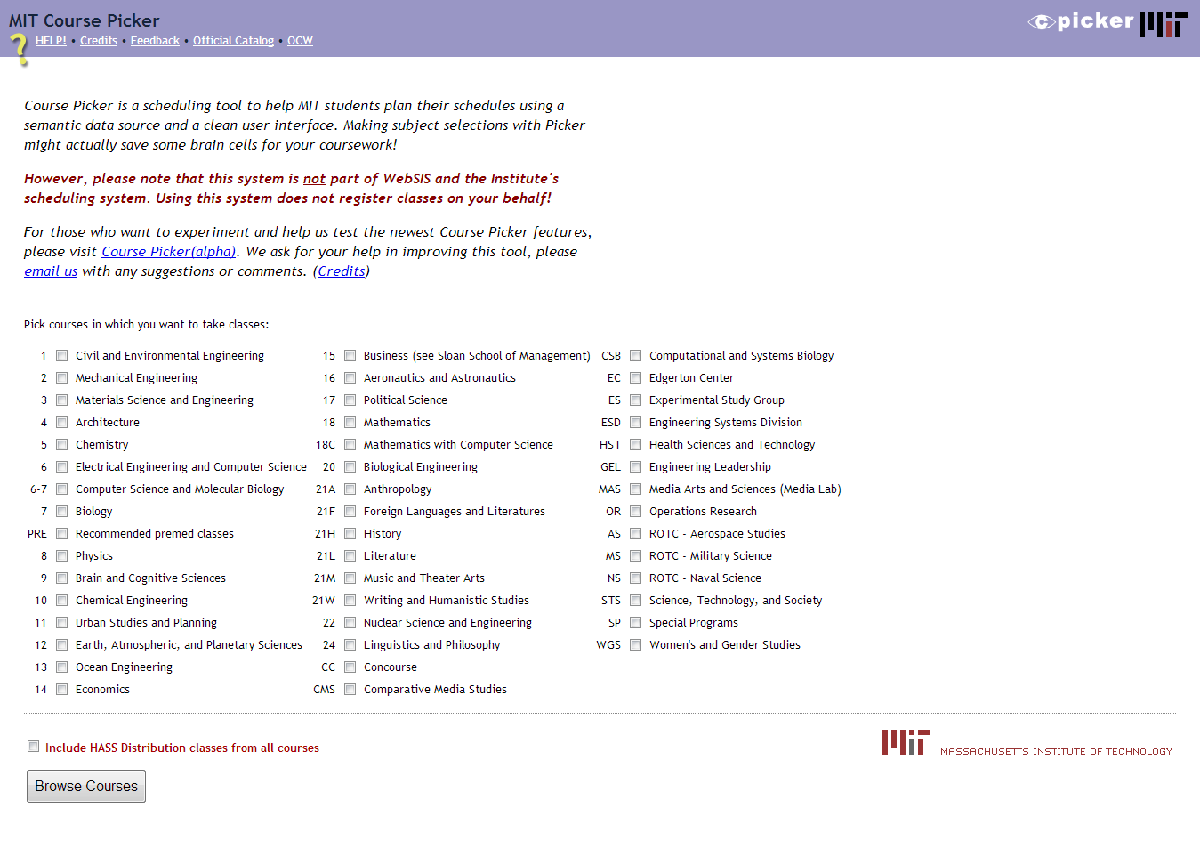
Related work
MIT Courses Picker project of MIT University

Slide 6
Curriculum regulations of Eurecom
In three semester:
At least 90 total credits, include:
At least 60 technical credits, in which:
At least 25 mandatory and 18 optional credits
At least 12 non-technical credits in three different subjects
At least 6 language credits and must be acquired in two foreign languages
In each semester, at least 2 language credits
In each semester, there are not two courses that take place at the same time

Slide 7
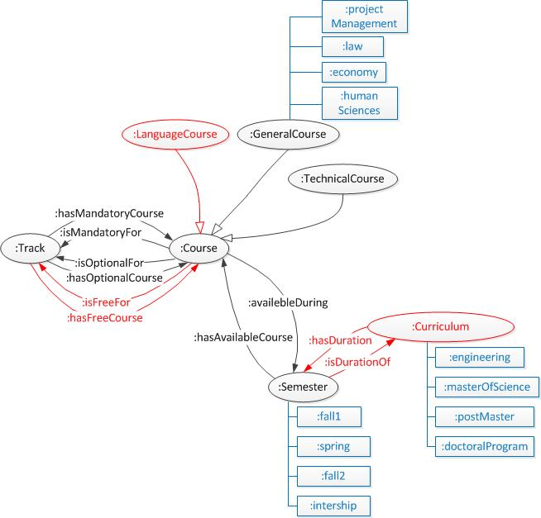
REVE ontology editing

Slide 8
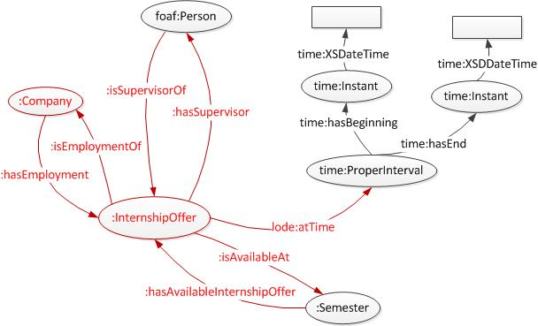
REVE ontology editing

Slide 9
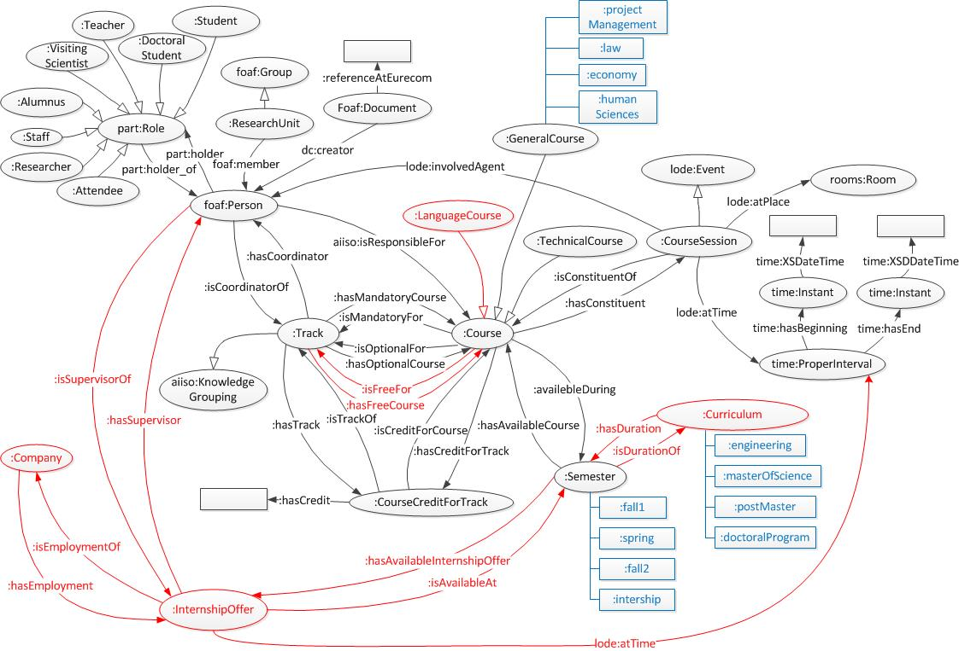
REVE2

Slide 10
TrackPicker process
Data in Euecom
(JSON files)
Converting data to RDF
Loading RDF data to server
Getting data to use
RDF triples
Triplestore
TrackPicker web application

Slide 11
TrackPicker architecture
Conversion module: Transforming data of the internal database of Eurecom in JSON format to RDF/XML data file.
Checking module: Checking the user’s choice such that it is satisfied with the curriculum regulations of Eurecom.
Recommendation module: Making the recommended track depend on the user’s choice.
Statistics module: Statistic the information about internship offer according to year, company and the number of internship offer.

Slide 12
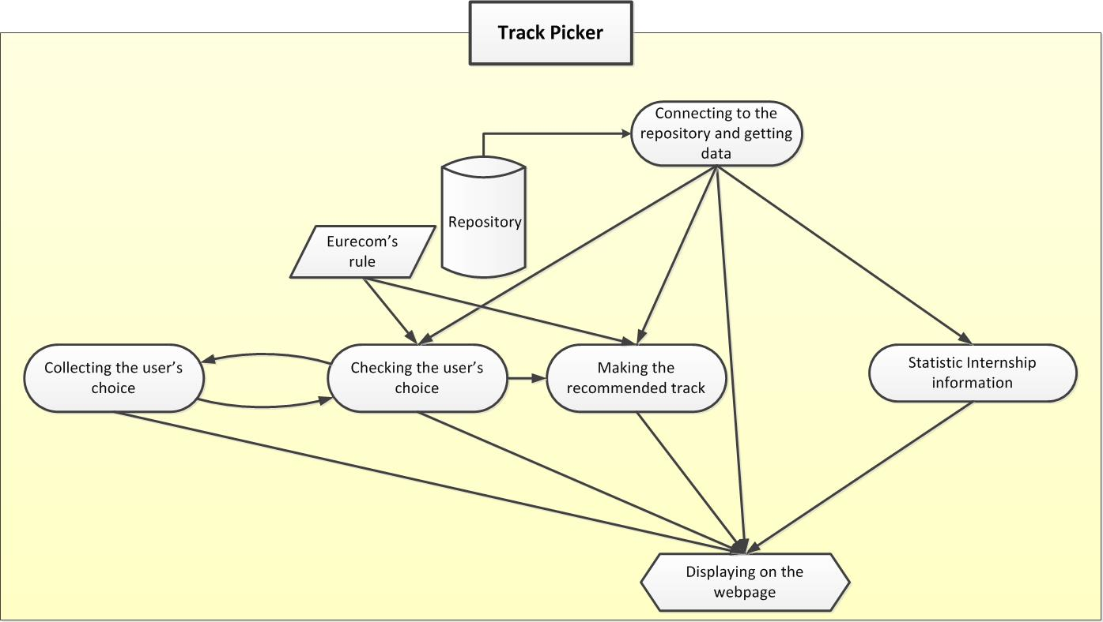
TrackPicker workflow

Slide 13
Data conversion
JSON Data files
Convert Data To RDF
RDF/XML files
Configuring file (configures input and output position)
Java language
Jena RDF API

Slide 14
Data conversion
Import the package of Jena:
com.hp.hpl.jena.rdf.model
com.hp.hpl.jena.ontology
OntModel modelAIISO = null;
String AIISO_URL= "http://vocab.org/aiiso/schema#";
modelAIISO = ModelFactory.createOntologyModel();
modelTrack.setNsPrefix("AIISO", AIISO_URL);
Resource eachTrack= modelTrack.createResource(eachTrackURI);
eachTrack.addProperty(modelAIISO.getProperty(AIISO_URL+"code"), modelTrack.createLiteral(track.get("code").toString()));

Slide 15
Data conversion
Input and output file configuration:
{
"input":
{
"track": [ {"name":"/Data/track.json"}
],
"course": [
{"name": "/Data/course.json"}
],
…
}
"output":
{
"track":{"name": "/OutputRDF/track.rdf"},
"course":{"name": "/OutputRDF/course.rdf"},
…
}
}

Slide 16
Track Picker Implementation
Choosing languages and techniques
HTML5
CSS3
Javascript
AJAX
Query language: SPARQL

Slide 17
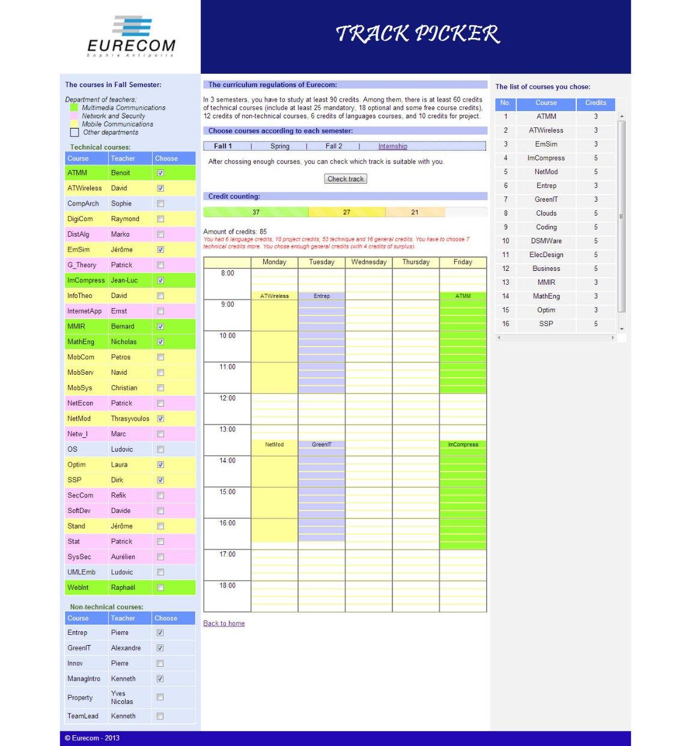
Track Picker Implementation
Collecting the user’s choice

Slide 18

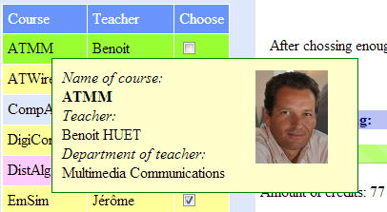
Track Picker Implementation
Displaying the course and teacher information in case of ATMM course

Slide 19

Track Picker Implementation
Checking the user’s choice

Slide 20

Making the recommended track
Choose the recommended track: The track which has the sum of the lack of mandatory credits and optional credits amount is smallest.
SUM (lack of mandatory credits, lack of optional credits) == smallest
$$C_{t}= \min_{t}\left(Sum\left(M−\sum_{j}^{m}{{MC}_{jt}},N−\sum_{k}^{n}{{OC}_{kt}}\right)\right)$$
$$with$$
$C_{t}∈list of available tracks$
$t ∈list of all tracks$
$M=number of mandatory credits that one student has to obtain$
$N=number of optional credits that one student has to obtain$
$m= number of mandatory courses chosen by user$
$n= number of optional courses chosen by user$
${MC}_{jt}=numberof credits of mandatory course j according to track t$
${OC}_{kt}=numberof credits of optinal course j according to track t$
$if card\left(C_{t}\right)=1, best solution$
$if card\left(C_{t}\right) !=1, we display all the possible choices to the users$

Slide 21
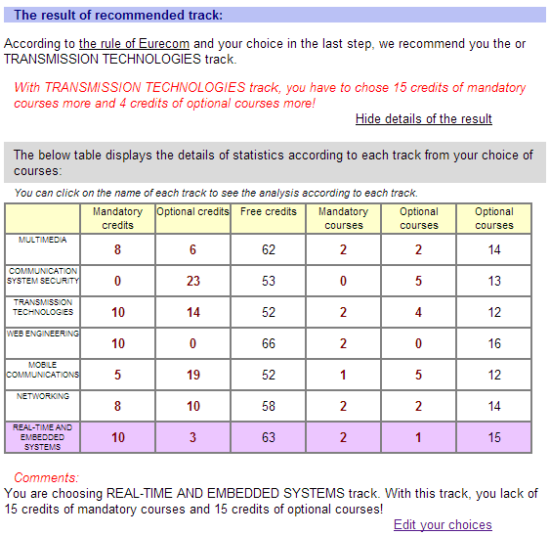
Track Picker Implementation
Making the recommended track

Slide 22

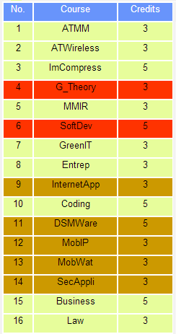
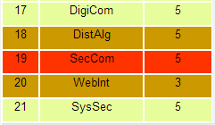
Track Picker Implementation

Slide 23
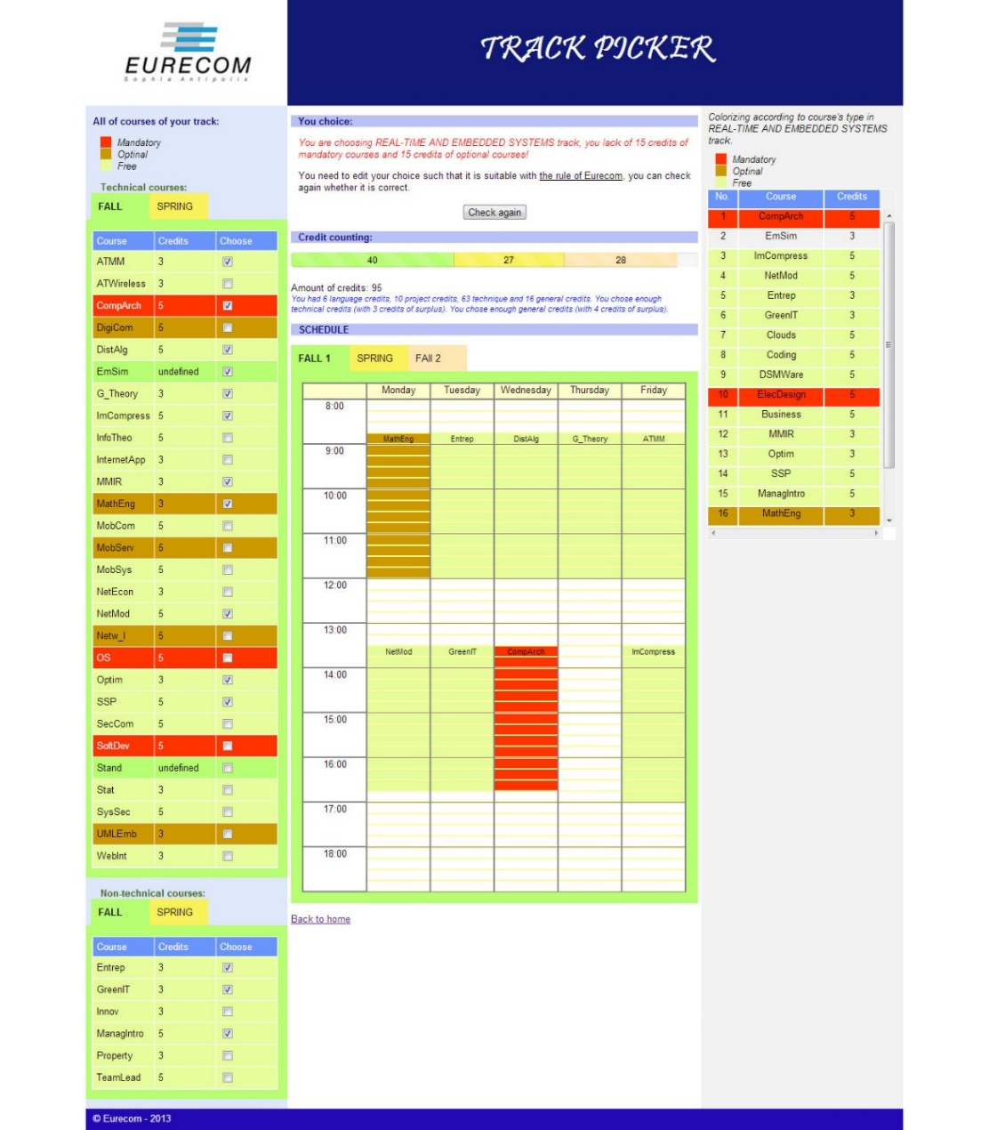
Track Picker Implementation
User’s choice editing page

Slide 24
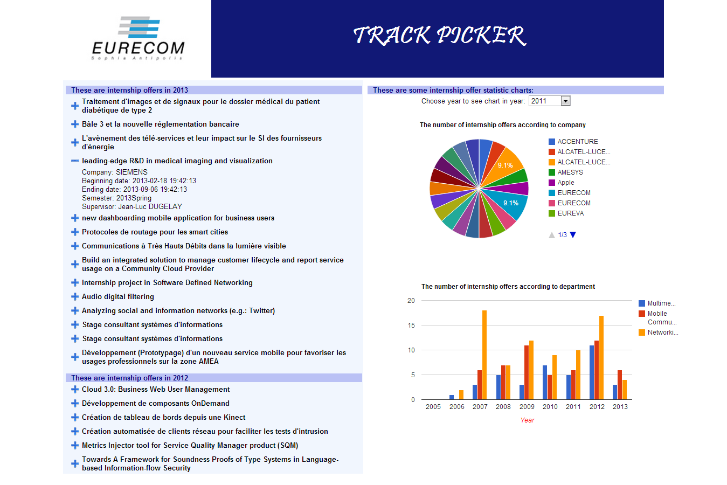
Track Picker Implementation
Internship page

Slide 25
Conclusion
Finishing the basic web application with the functions in the requirement: help user choose courses, help user arrange the schedule, suggest the suitable track.
In the progress of making the TrackPicker application:
Find out some lacks of information in the Eurecom data:
The teacher’s department
Type of course and number of credits of some courses
Creating the demand for supplementing the information:
Image of teacher
Internship offer information

Slide 26
Project improvement – Future work
Solve problems of updating data – Reread data directly from Eurecom server according to the defined time frame.
The function for user can take notes on the calendar and export this timetable and notes for user.
The integration of social profile of the user in the recommendation process.

Slide 27


Slide 28
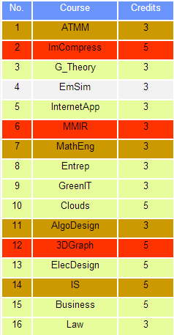
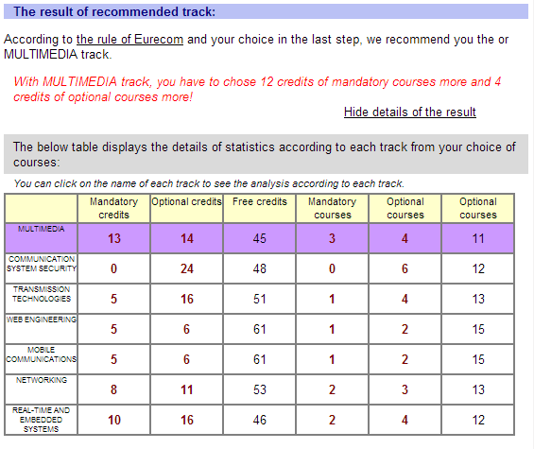
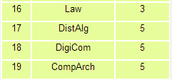
Example of recommended track (1)

Slide 29
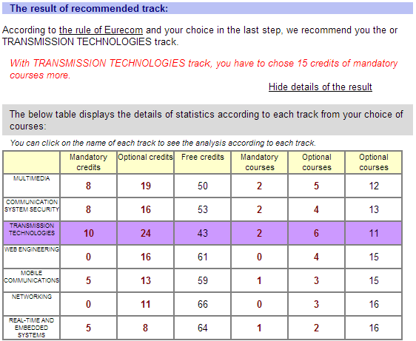
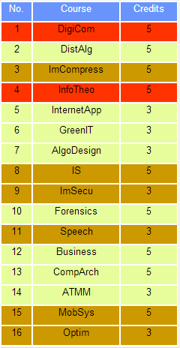
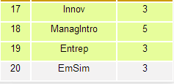
Example of recommended track (2)

Slide 30
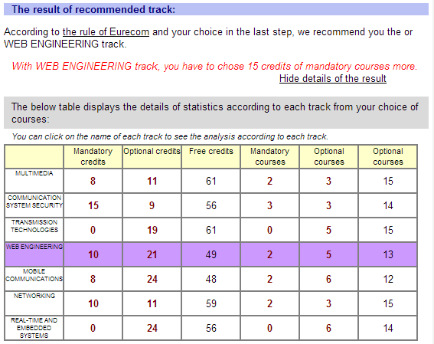
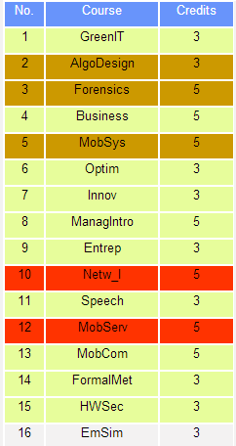
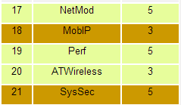
Example of recommended track (3)

Slide 31
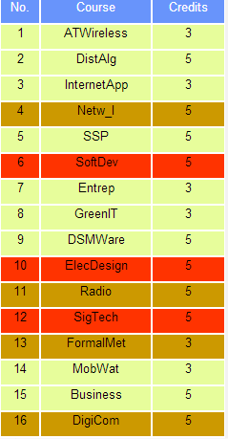
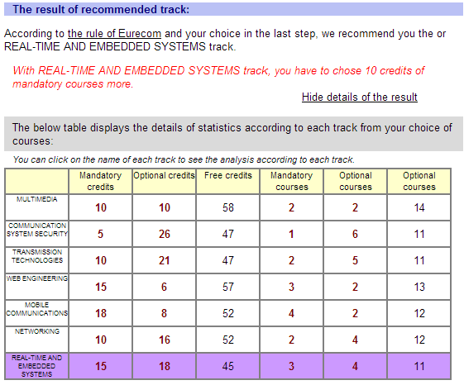

Example of recommended track (4)

Slide 32
Appendix - The way of processing
Getting data: using AJAX to get data from triplestore by JSON format and storing in some array to use in each time of page loaded.
Course information array:
Course – track information:
 | Course’s name | Description | Teacher’s name | Teacher’s image | Teacher’s department
Course 1
….
Course n
 | Course 1 | Course 2 | …. | Course n
Track 1 (type of course) | Mandatory | Free |  | Optional
Track 1 (credit amount) | 5 | 3 |  | 5
… | … | … | … | …
Track n (type of course) | Free | Mandatory |  | Optional
Track n (credit amount) | 3 | 3 |  | 5

Slide 33
Appendix - The way of processing
Using web storage (SessionStorage) to store necessary values when moving the other pages
Making the summary from the user’s choice of courses
Summary from the user’s choice | Mandatory credits | Optional credits | Free Credits | Mandatory course amount | Optional course amount | Free course amount | The lacked amount of mandatory credits | The lacked amount of optional credits
Track 1 | 15 | 16 | 30 | 3 | 4 | 6 | 10 | 2
Track 2 | 5 | 6 | 50 | 1 | 2 | 14 | 20 | 12
… | … | … | … | …
Track n | 8 | 21 | 32 | 2 | 5 | 10 | 17 | -3 (surplus 3)

